Slide 1





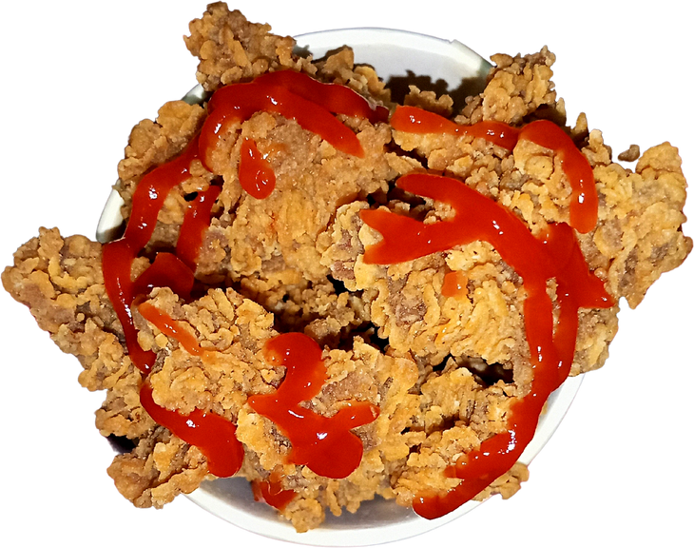






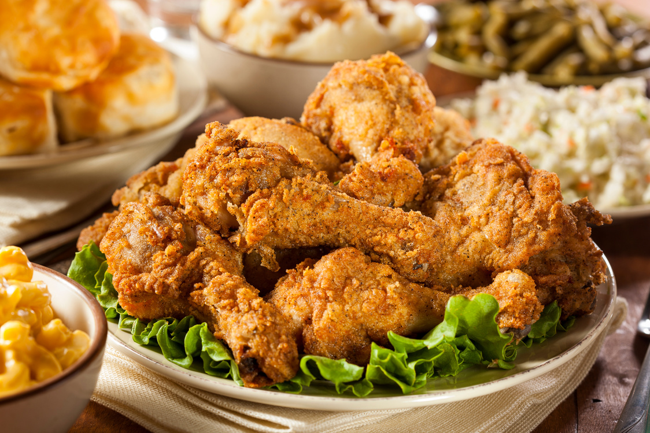
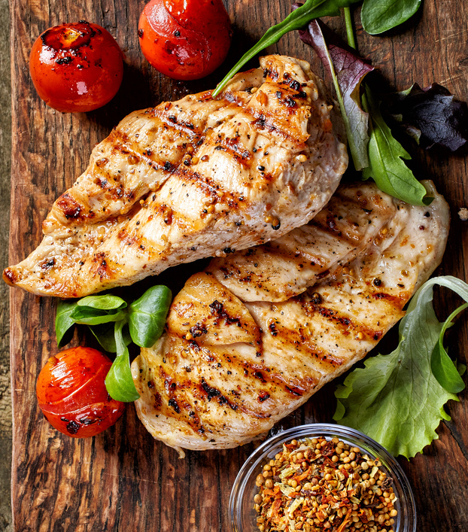
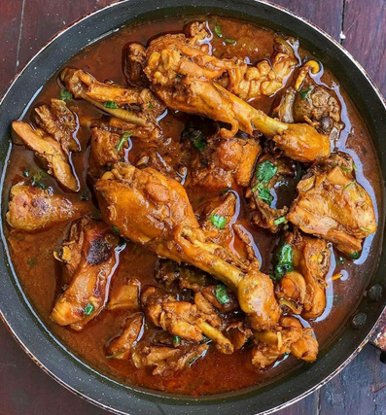

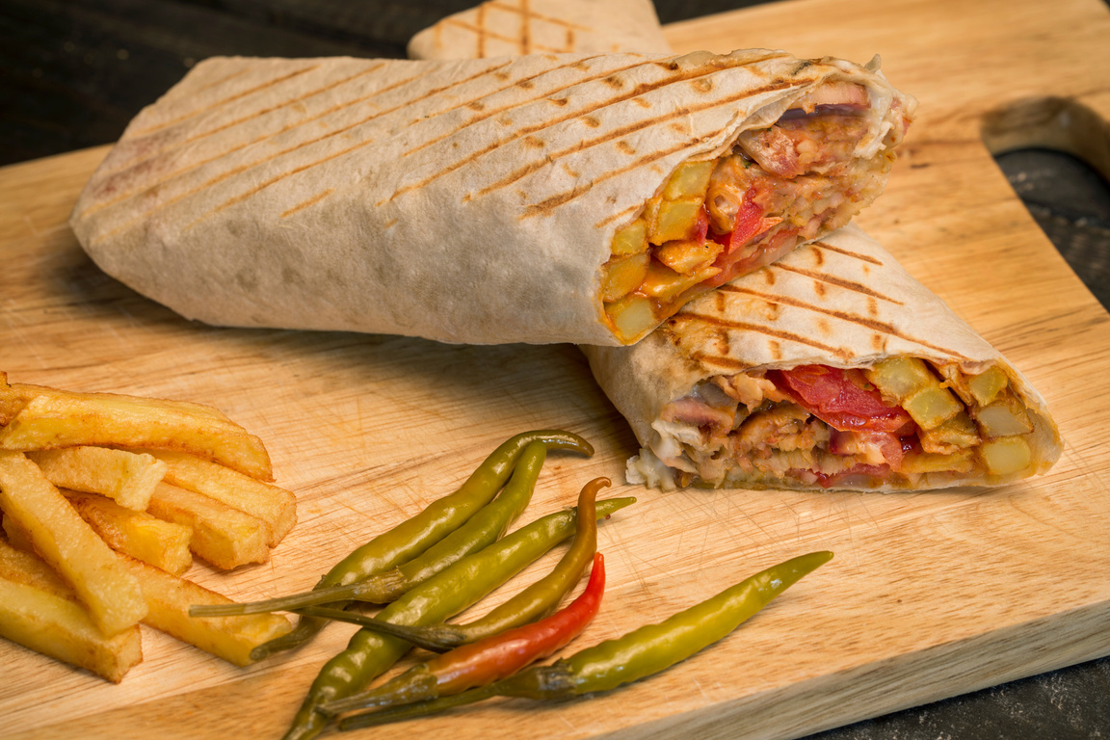
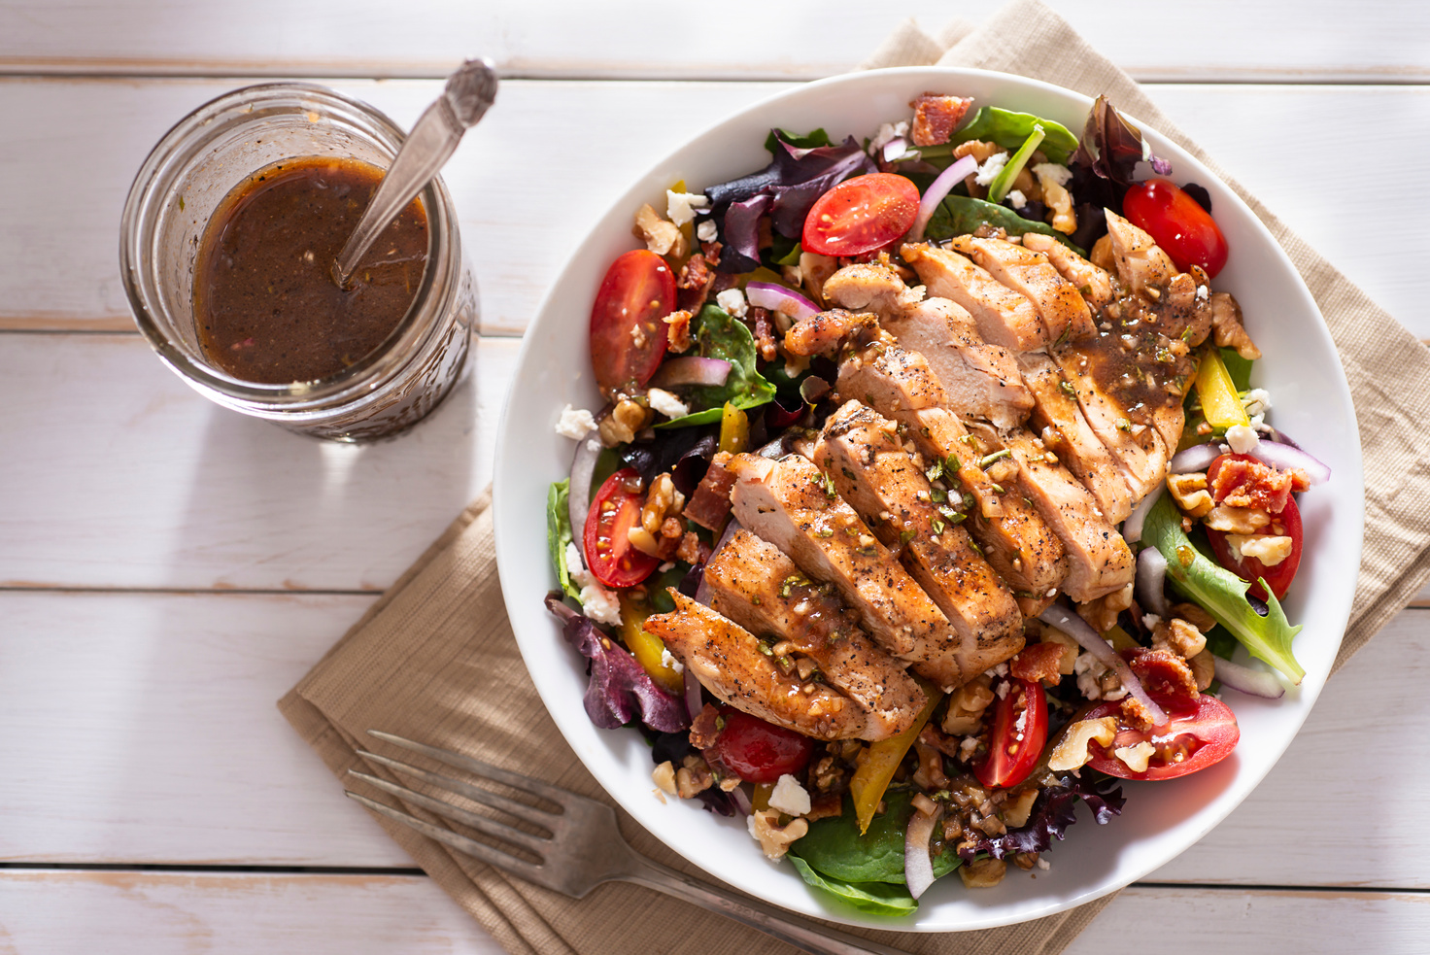

CHICKEN
Menu
$2
Chicken
Bowl
Delivery Order
+123-456-7890
Fried Chicken
Grilled Chicken
Chicken Curry
$2
$4
$2
Chicken Kebab
Chicken Salad
Chicken Soup
$2
$2
$4

